Slide 1
Web Development using React js
Lecturer name
Lecturer
Faculty of Computer & IT
Jamahiriya University of Science & Technology

Slide 2
Chapter #5
useState Hook
Effect Hook
Building Your Own Hooks(Custom Hook)
Implementing react Hooks

Slide 3
Hooks
As we have seen last Chapter Hooks are a new addition in React 16.8. They let you use state and other React features without writing a class.
React provides a few built-in Hooks like useState. You can also create your own Hooks to reuse stateful behavior between different components. We’ll look at the built-in Hooks first.
useState
useEffect

Slide 4
useState Hook
useState is a Hook (function) that allows you to have state variables in functional components.
You pass the initial state to this function and it returns a variable with the current state value (not necessarily the initial state) and another function to update the state value.

Slide 5
useState Hook
Here we’ll cover useState with simple types, as well as useState with objects and arrays. We’ll also see a couple ways of storing multiple values.
What Does the React.useState Hook Do?
The useState hook lets you add state to function components.
By calling React.useState inside a function component, you create a single piece of state associated with that component. (every hook starts with the word “use”; a call to useState literally lets you “use state” in a function component)

Slide 6
useState Hook
In class components, the state was always an object, and you could store multiple values in that object.
But with hooks, the state can be any type you want – you can useState with an array, useState an object, a number, a boolean, a string, whatever you need.
Each call to useState creates a single piece of state, holding a single value of any type.
Notes:
Web framework: It is a software framework that was developed in order to simplify the web development process and make it easier to build a website. It includes templating capabilities that allow you to present information within a browser, provides an environment for scripting how information flows and also contains many application programming interfaces (APIs) for gaining access to underlying data resources.

Slide 7
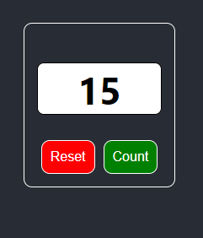
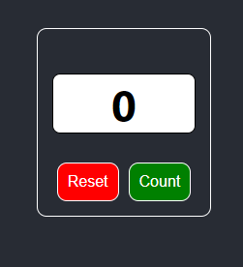
Implementation of useState Hook
Let’s see the following counter example
We will create a react project with that uses useState hook to implement counter application with below UI.

Slide 8
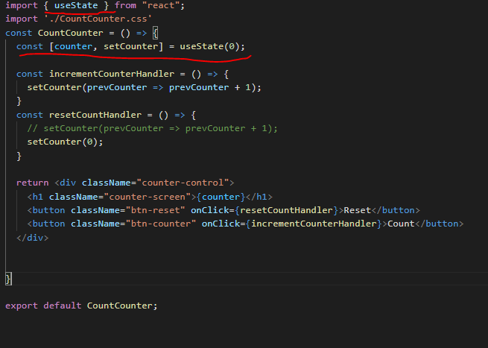
Implementation of useState Hook
To implement the counter app we have created a user defined component and its style sheet.

Slide 9
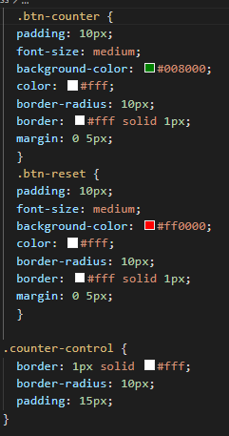
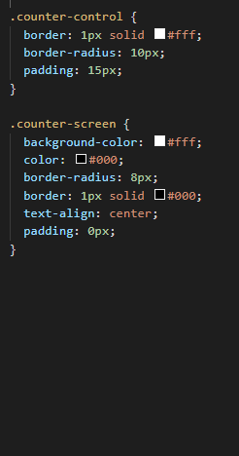
Implementation of useState Hook
Custom css

Slide 10
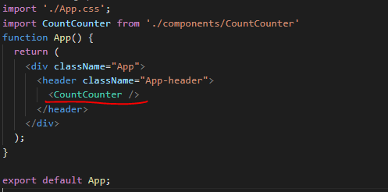
Implementation of useState Hook
The snipped below shows how CountCounter(user defined) component called inside App Component

Slide 11
Recap of Counter App
We import the useState Hook from React. It lets us keep local state in a function component.
Inside the Example component, we declare a new state variable by calling the useState Hook.
It returns a pair of values, to which we give names. We’re calling our variable counter because it holds the number of button clicks.
We initialize it to zero by passing 0 as the only useState argument.
The second returned item is itself a function. It lets us update the counter so we’ll name it setCounter.

Slide 12
Recap of Counter App
In our CountCounter component we have 2 buttons reset and count.
when user clicks count button we call incrementCounterHandler which calls setCounter with a new value and React will then re-render the CountCounter component, passing the new counter value to it.
And reset buttons calls resetCountHandler to set counter value to its initial state value which is 0.

Slide 13

What Do Square Brackets Mean ?
You might have noticed the square brackets when we declare a state variable.
The names on the left aren’t a part of the React API. You can name your own state variables.
This JavaScript syntax is called array Destructuring. It means that we’re making two new variables counter and setCounter, where counter is set to the first value returned by useState, and setCounter is the second.

Slide 14
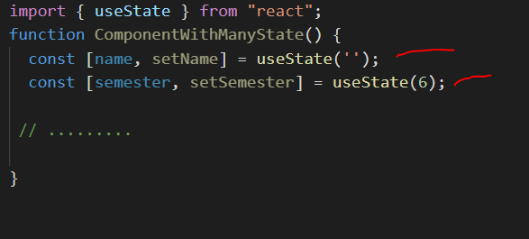
Using Multiple State Variables
Declaring state variables as a pair of [something, setSomething] is also useful because it lets us give different names to different state variables if we want to use more than one.

Slide 15
Using Multiple State Variables
The array Destructuring syntax lets us give different names to the state variables we declared by calling useState. These names aren’t a part of the useState API. Instead, React assumes that if you call useState many times, you do it in the same order during every render.

Slide 16
useEffect Hook
You’ve likely performed data fetching, subscriptions, or manually changing the DOM from React components before.
We call these operations side effects or effects for short because they can affect other components and can’t be done during rendering.
The Effect Hook, useEffect, adds the ability to perform side effects from a function component.
It serves the same purpose as componentDidMount, componentDidUpdate, and componentWillUnmount in React classes, but unified into a single API.

Slide 17
useEffect Hook
Common side effects include:-
Making a request to an API for data from a backend server.
To interact with browser APIs (that is, to use document or window directly).
Using unpredictable timing functions like setTimeout or setInterval.
This is why useEffect exists: to provide a way to handle performing these side effects in what are otherwise pure React components.
For example, if we wanted to change the title meta tag to display the user's name in their browser tab, we could do it within the component itself.

Slide 18
useEffect Hook
Common side effects include:-
Making a request to an API for data from a backend server.
To interact with browser APIs (that is, to use document or window directly).
Using unpredictable timing functions like setTimeout or setInterval.
This is why useEffect exists: to provide a way to handle performing these side effects in what are otherwise pure React components.
For example, if we wanted to change the title meta tag to display the user's name in their browser tab, we could do it within the component itself.

Slide 19
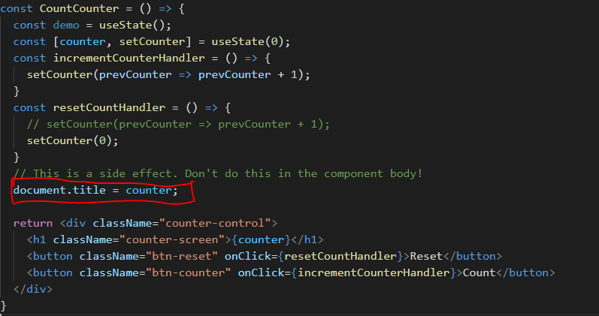
useEffect Hook
Let’s see simple Example

Slide 20
useEffect Hook
If we perform a side effect directly in our component body, it gets in the way of our React component's rendering.
Side effects should be separated from the rendering process. If we need to perform a side effect, it should strictly be done after our component renders.
In short, useEffect is a tool that lets us interact with the outside world but not affect the rendering or performance of the component that it's in.

Slide 21
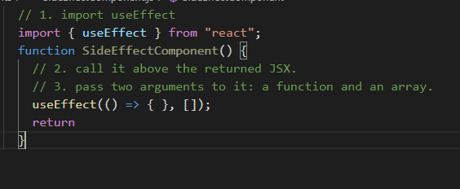
How do we use useEffect?
The basic syntax of useEffect is as follows:

Slide 22
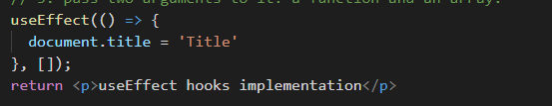
How do we use useEffect?
The correct way to perform the side effect in our User component is as follows:
We import useEffect from "react“.
We call it above the returned JSX in our component.
We pass it two arguments: a function and an array.

Slide 23
How do we use useEffect?
The function passed to useEffect is a callback function. This will be called after the component renders.
The second argument is an array, called the dependencies array. This array should include all of the values that our side effect relies upon.
In our example above, since we are changing the title based off of a value in the outer scope, Title, we need to include that within the dependencies array.

Slide 24
How do we use useEffect?
What this array will do is it will check and see if a value (in this case title) has changed between renders. If so, it will execute our use effect function again.
This makes sense because if the title changes, we want to display that changed title and therefore run our side effect again.

Slide 25
How to fix common mistakes with useEffect
There are some subtle details to be aware of avoid mistakes with useEffect.
If you do not provide the dependencies array at all and only provide a function to useEffect, it will run after every render.
This can lead to problems when you're attempting to update state within your useEffect hook.
If you forget to provide your dependencies correctly and you are setting a piece of local state when the state is updated, the default behavior of React is to re-render the component. And therefore, since useEffect runs after every single render without the dependencies array, we will have an infinite loop.

Slide 26
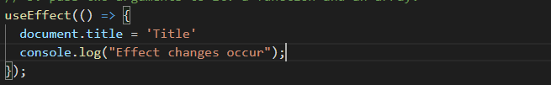
How to fix common mistakes with useEffect
There are some subtle details to be aware of avoid mistakes with useEffect.
// Error! useEffect runs after every render without the dependencies array, causing infinite loop.

Slide 27
How to fix common mistakes with useEffect
After the first render, useEffect will be run, state will be updated, which will cause a re-render, which will cause useEffect to run again, starting the process over again and again.
This is called an infinite loop and this effectively breaks our application.
If you are updating state within your useEffect, make sure to provide an empty dependencies array. If you do provide an empty array, which I recommend you do by default for any time that you use useEffect, this will cause the effect function to only run once after the component has rendered the first time.

Slide 28
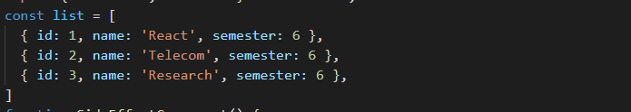

How to fix common mistakes with useEffect
A common example for this is to fetch data. For a component, you may just want to fetch data once, put it in state, and then display it in your JSX.
We have below list which we want to display once.

Slide 29
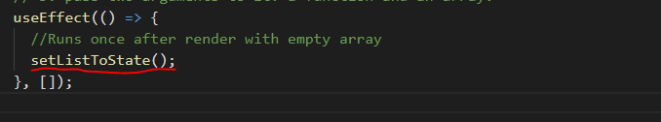
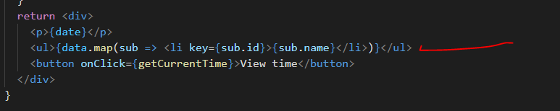
How to fix common mistakes with useEffect

Slide 30
What is the cleanup function in useEffect?
The final part of performing side effects properly in React is the effect cleanup function.
Sometimes our side effects need to be shut off. For example, if you have a countdown timer using the setInterval function, that interval will not stop unless we use the clearInterval function.
If we are setting state using setInterval and that side effect is not cleaned up, when our component unmounts and we're no longer using it, the state is destroyed with the component – but the setInterval function will keep running.

Slide 31
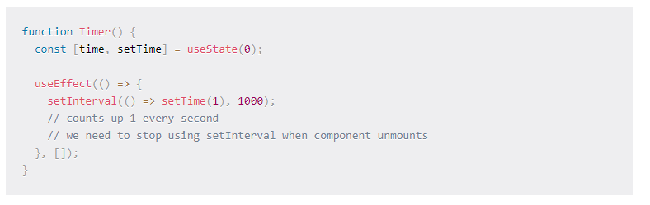
What is the cleanup function in useEffect?
The problem with this if the component is destroying, is that setInterval will try to update a variable a piece of state time that no longer exists. This is an error called a memory leak.

Slide 32
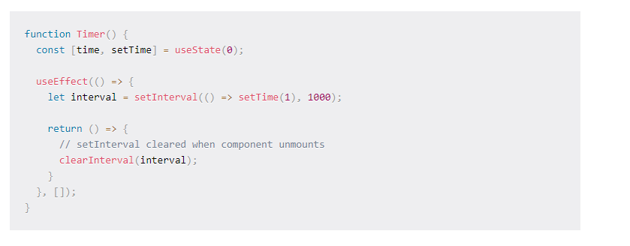
What is the cleanup function in useEffect?
To use the cleanup function, we need to return a function from within the useEffect function.
Within this function we can perform our cleanup, in this case to use clearInterval and stop setInterval.

Slide 33
What is the cleanup function in useEffect?
The cleanup function will be called when the component is unmounted.
A common example of a component being unmounted is going to a new page or a new route in our application where the component is no longer rendered.
When a component is unmounted, our cleanup function runs, our interval is cleared, and we no longer get an error of attempting to update a state variable that doesn't exist.
Finally, the side effect cleanup is not required in every case. It is only required in a few cases, such as when you need to stop a repeated side effect when your component unmounts.

Slide 34
React Lists
Lists are used to display data in an ordered format and mainly used to display menus on websites. In React, Lists can be created in a similar way as we create lists in JavaScript. Let us see how we transform Lists in regular JavaScript
In React, you will render lists with some type of loop.
The JavaScript map() array method is generally the preferred method

Slide 35
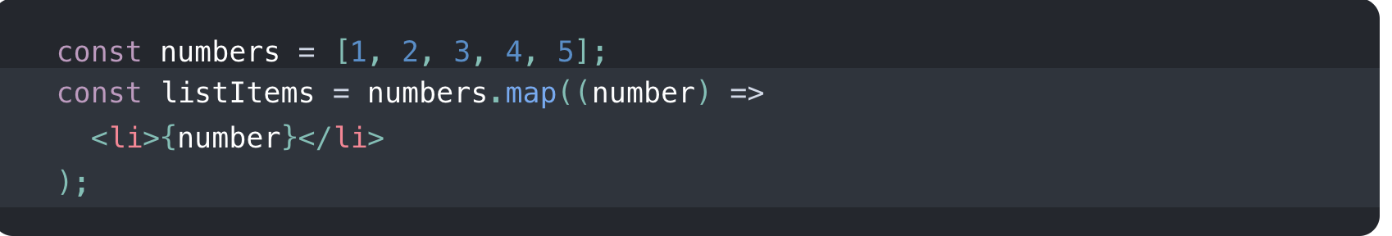
Rendering Multiple Components
You can build collections of elements and include them in JSX using curly braces {}.
Below, we loop through the numbers array using the JavaScript map() function. We return a <li> element for each item. Finally, we assign the resulting array of elements to listItems:

Slide 36
Rendering Multiple Components
Then, we can include the entire listItems array inside a <ul> element:

Slide 37
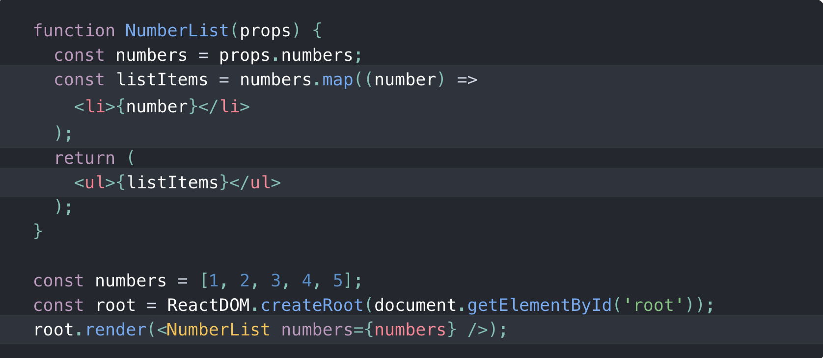
Basic List Component

Slide 38
Missing key issue
When you run this code, you’ll be given a warning that a key should be provided for list items. A “key” is a special string attribute you need to include when creating lists of elements. We’ll discuss why it’s important in the next section.
Let’s assign a key to our list items inside numbers.map() and fix the missing key issue

Slide 39
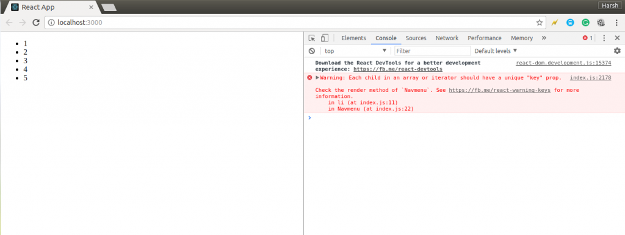
Missing key issue

Slide 40
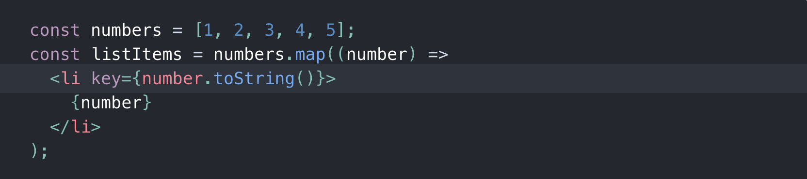
Keys
Keys help React identify which items have changed, are added, or are removed. Keys should be given to the elements inside the array to give the elements a stable identity

Slide 41
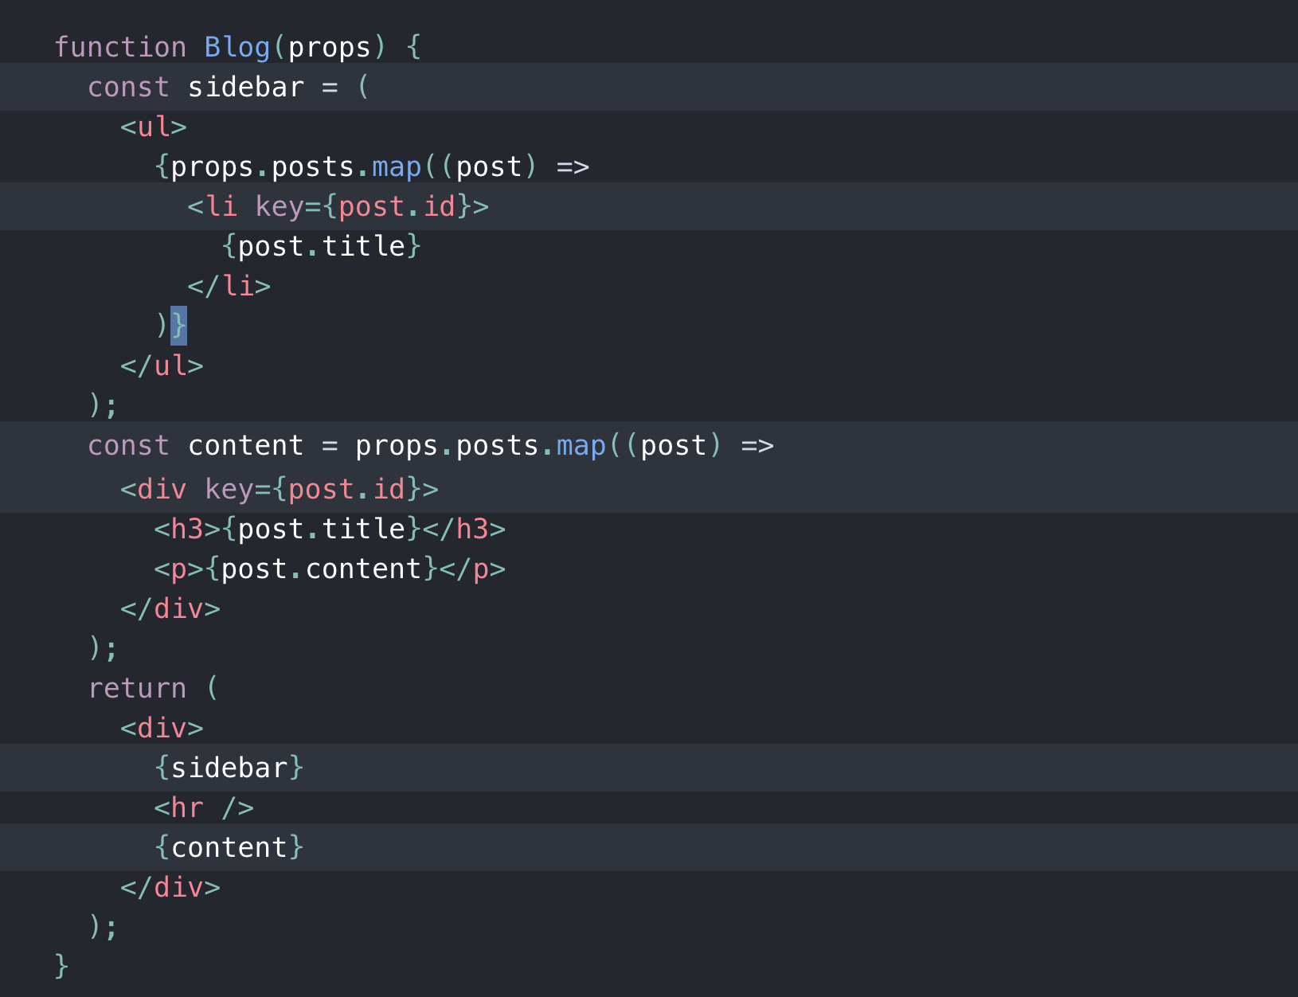
Example

Slide 42
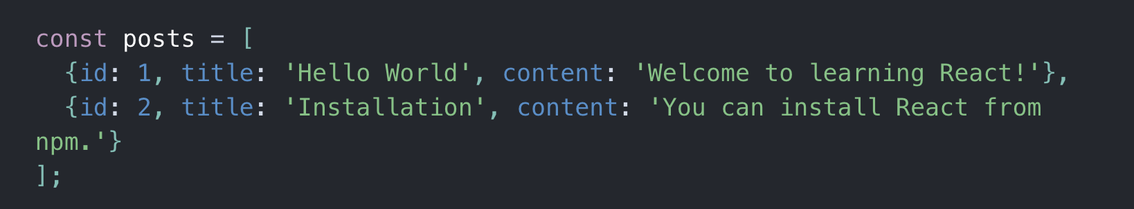
Example

Slide 43
END.

